Slide 1
Initial analysis of snRNA from 16 samples across six donors
1. cellranger count performs alignment, filtering, barcode counting, and UMI counting
2. SoupX to remove ambient RNA contamination
3. Seurat v5 processing on corrected counts
1. Per sample: QC > Normalize > PCA > UMAP > Compute nearest neighbors > Identify Clusters
2. Combine all samples > Normalize > PCA > UMAP > Compute nearest neighbors > Identify Clusters
4. Assess batch effect (no obvious batch effect, no integration)
5. Plot expression of cell type markers in UMAP space
1. Established markers (as listed in Elgamal et al. 2023 )
2. Top cluster markers from Elgamal et al. 2023

Slide 2
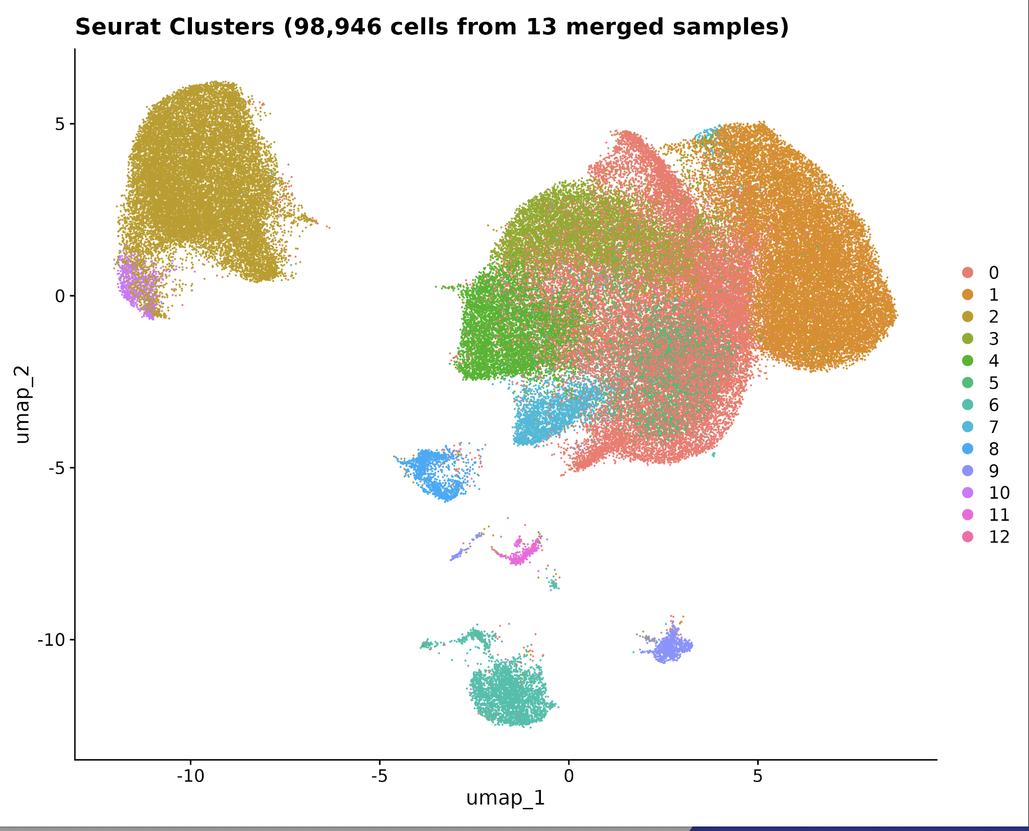

Slide 3
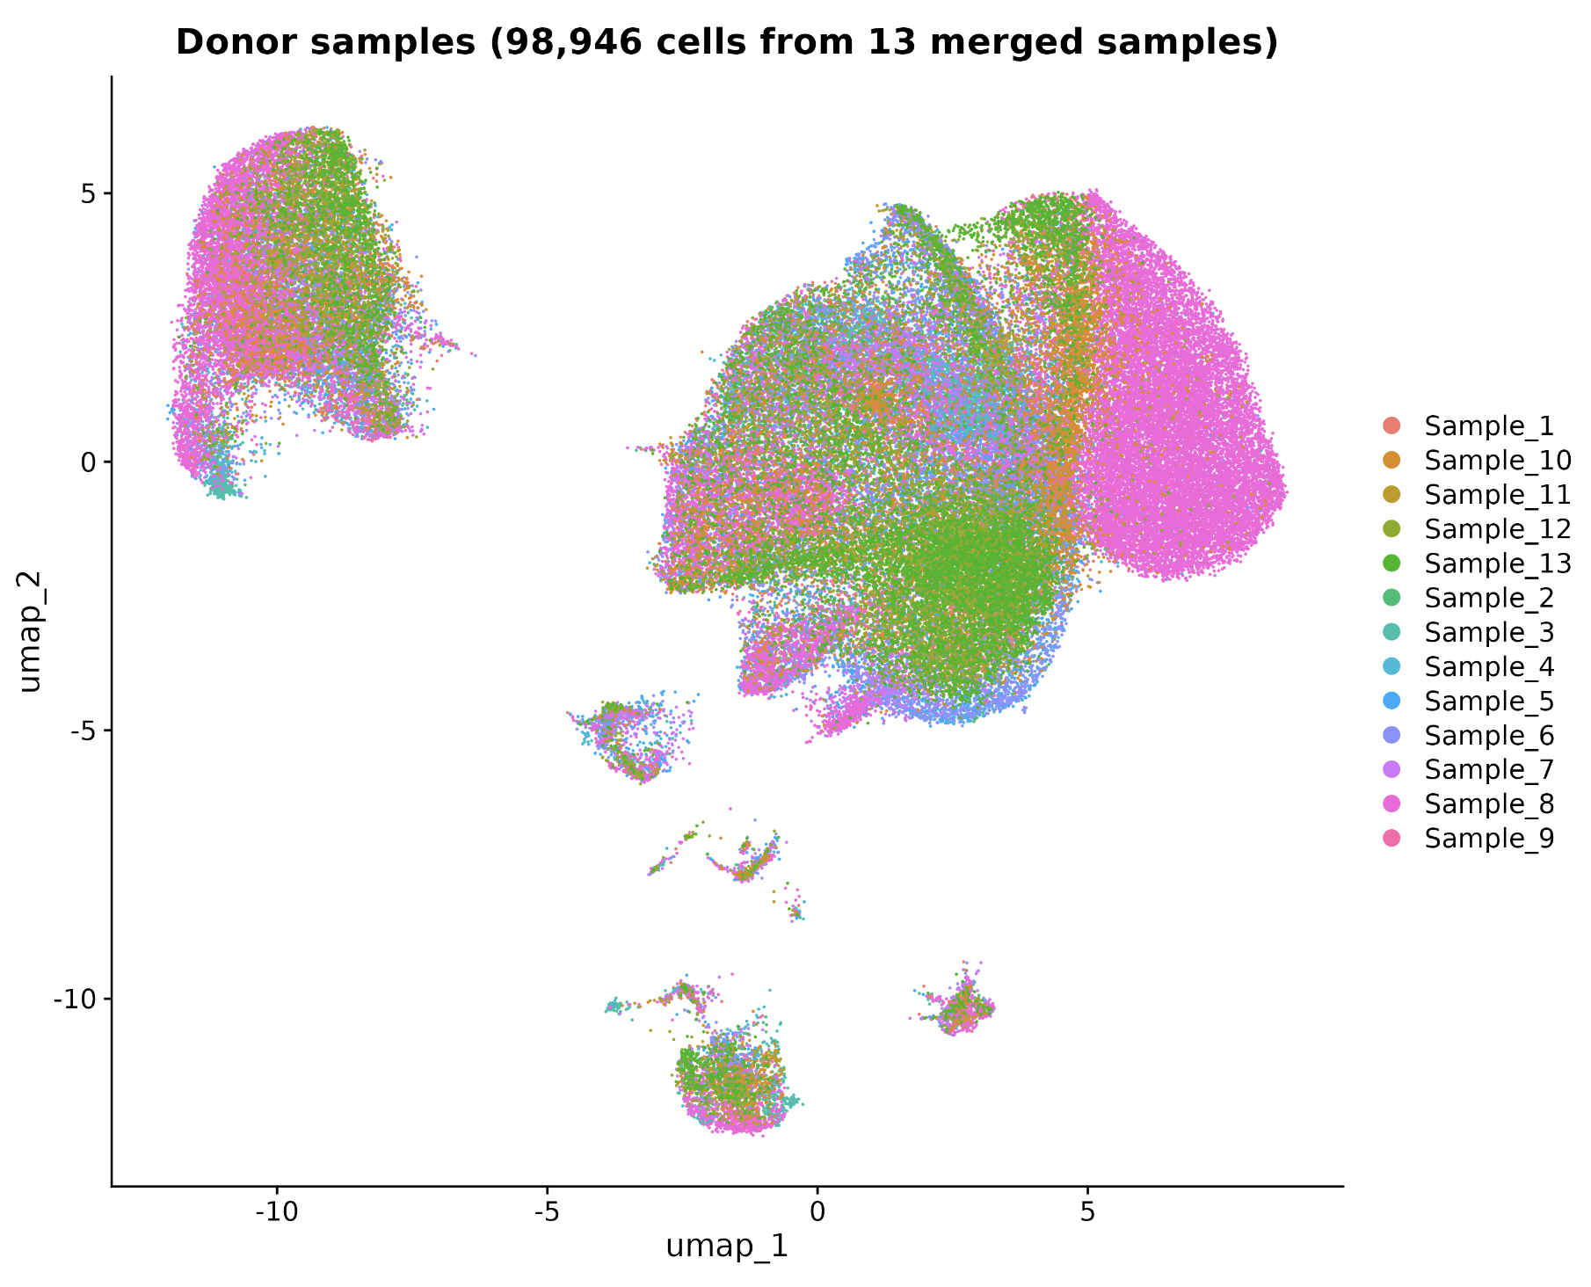

Slide 4
Rough annotation of ”clusters” based on marker gene expression
ductal
acinar
alpha
beta
Macrophage + mast
endothelial
Stellate

Slide 5
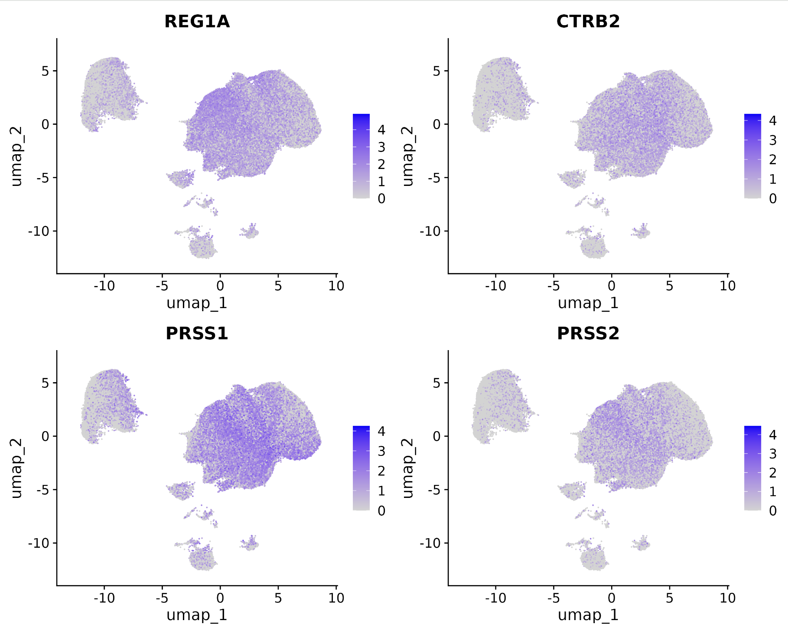
Scaled expression of established acinar cell type markers

Slide 6
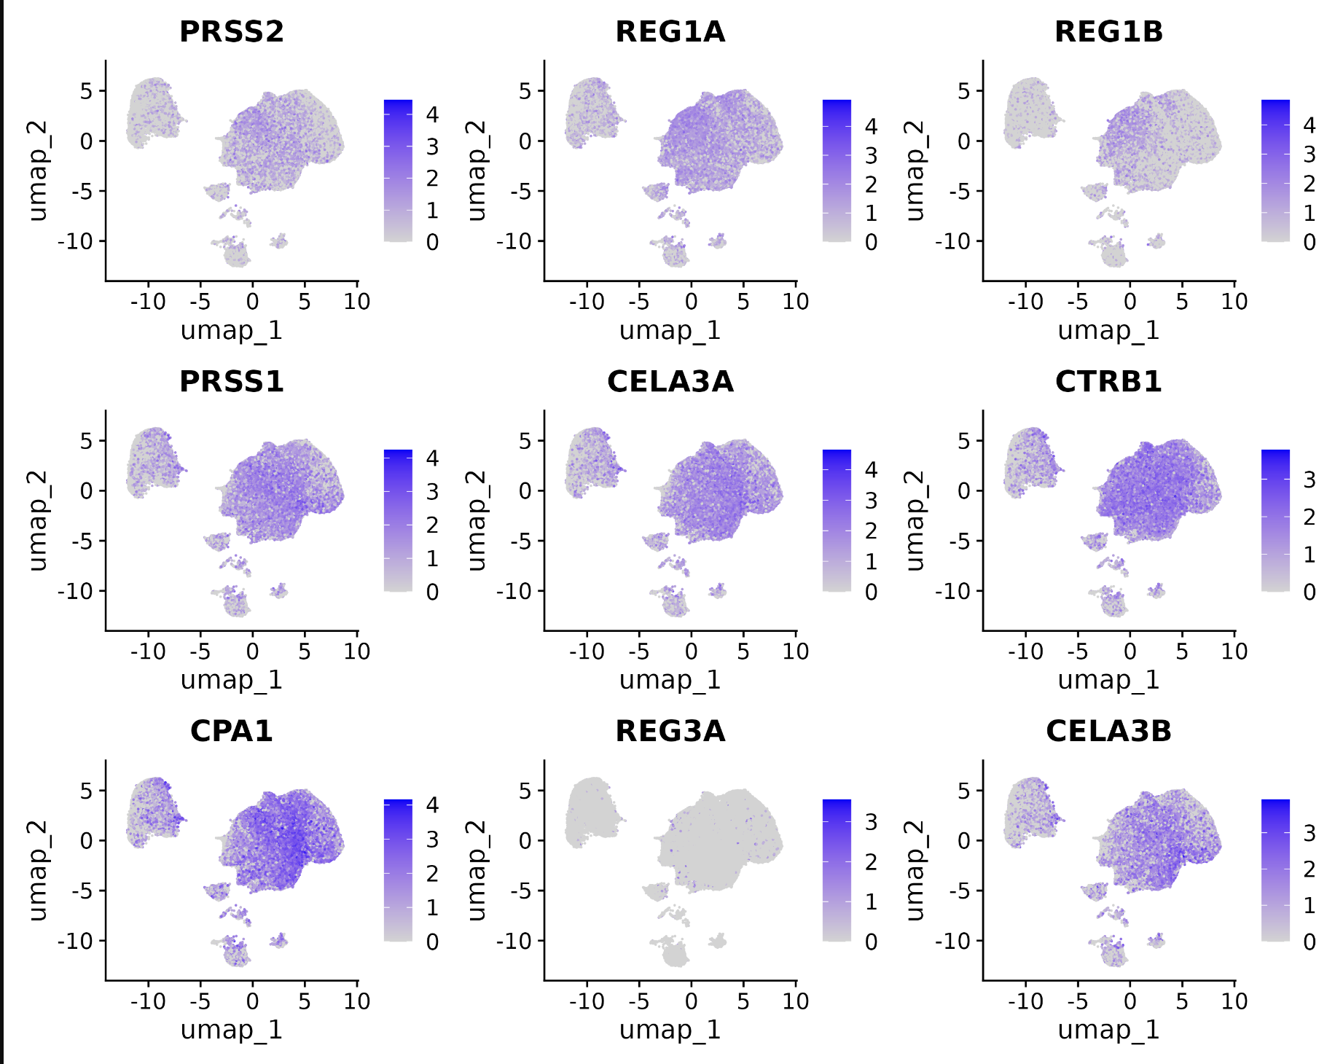
Scaled expression of additional acinar cell type markers

Slide 7
Scaled expression of established alpha cell type markers

Slide 8
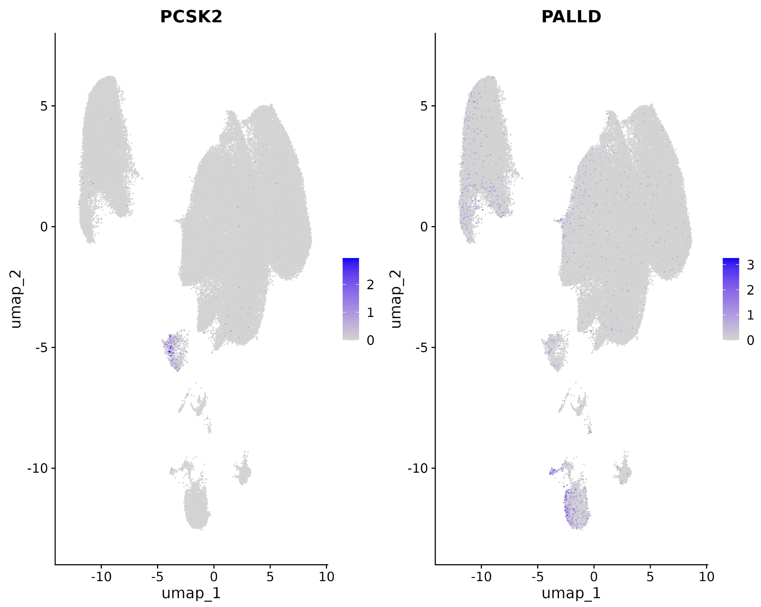
Scaled expression of additional alpha cell type markers

Slide 9
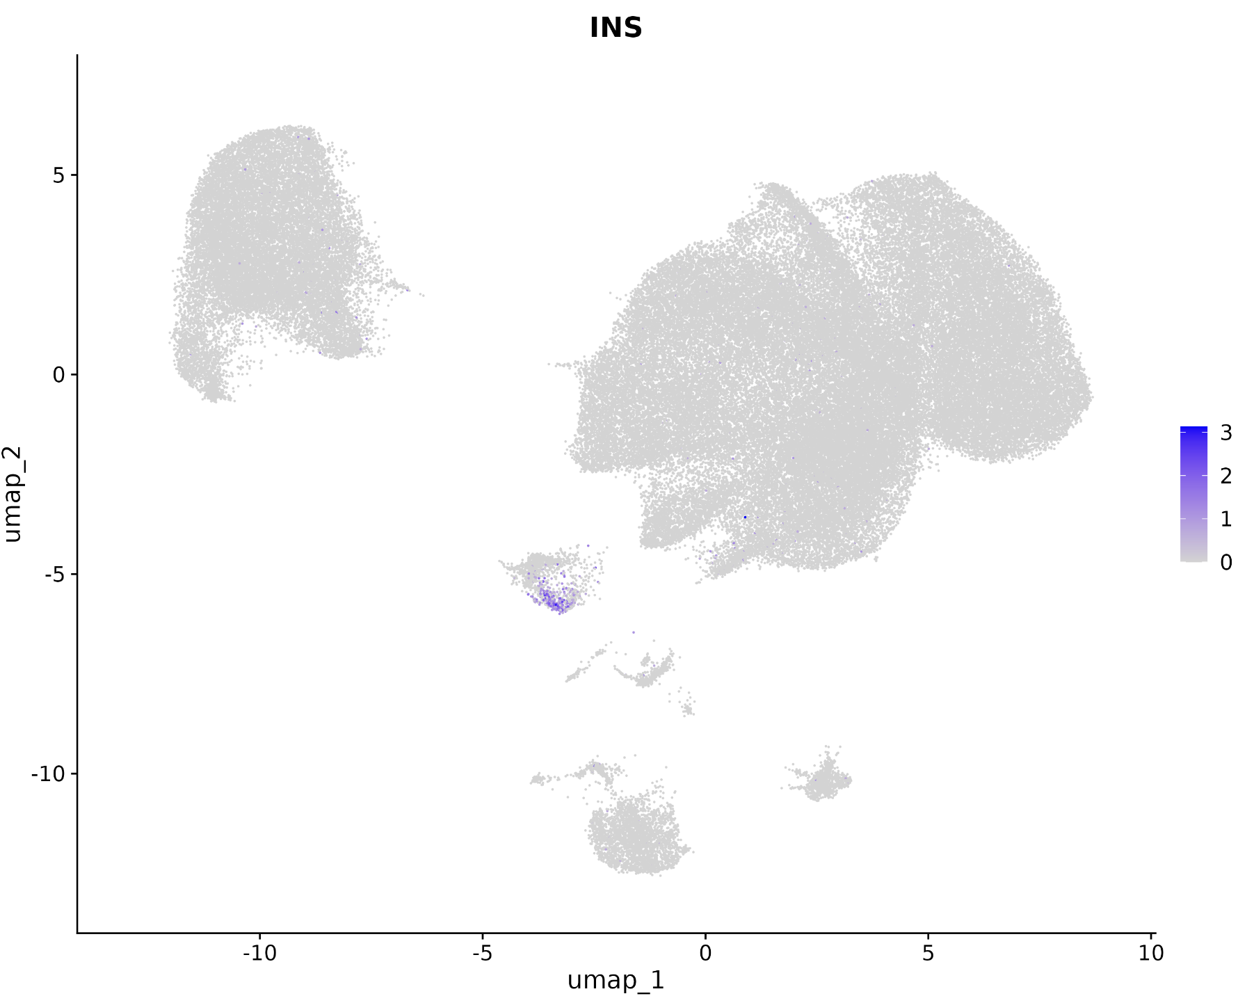
Scaled expression of established beta cell type markers

Slide 10
Scaled expression of additional beta cell type markers

Slide 11
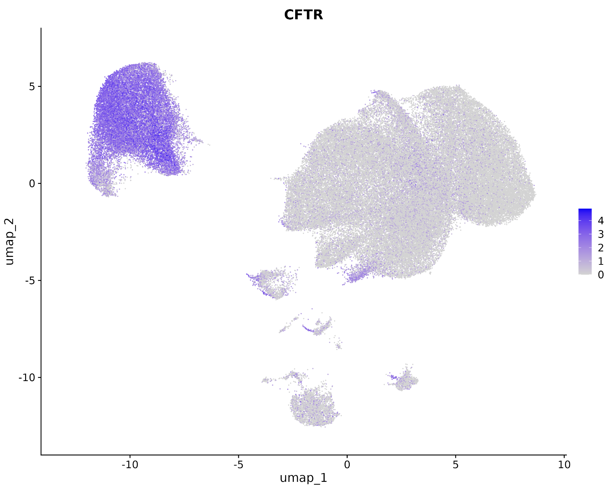
Scaled expression of established ductal cell type markers

Slide 12
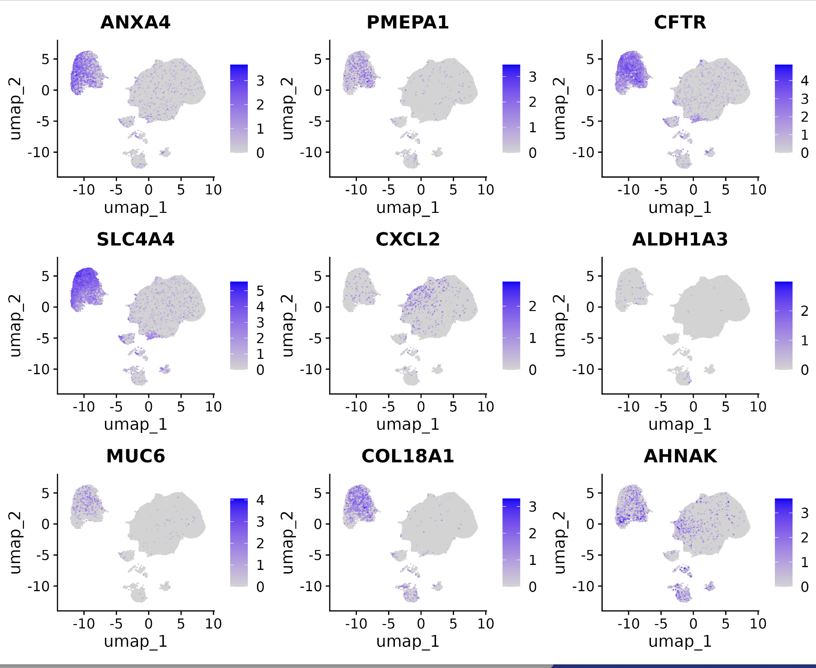
Scaled expression of additional ductal cell type markers

Slide 13
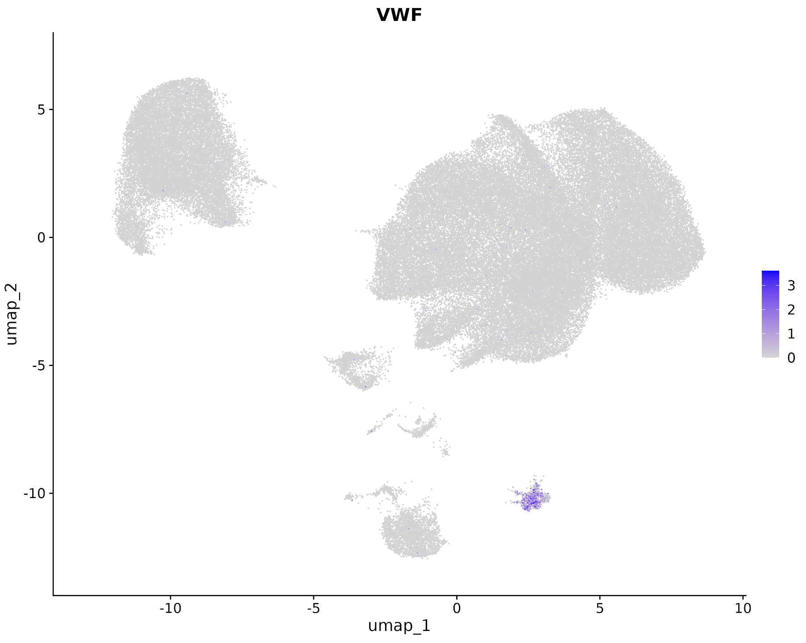
Scaled expression of established endothelial cell type markers

Slide 14
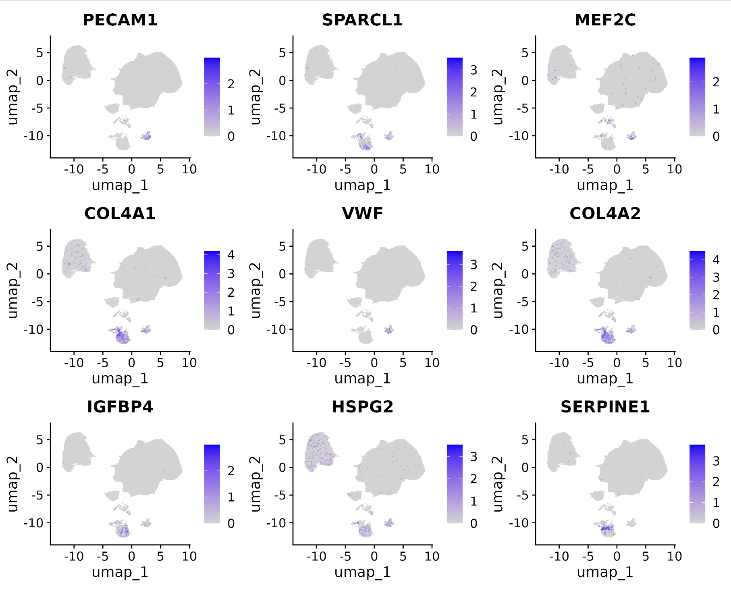
Scaled expression of additional endothelial cell type markers

Slide 15
Scaled expression of established macrophage cell type markers

Slide 16
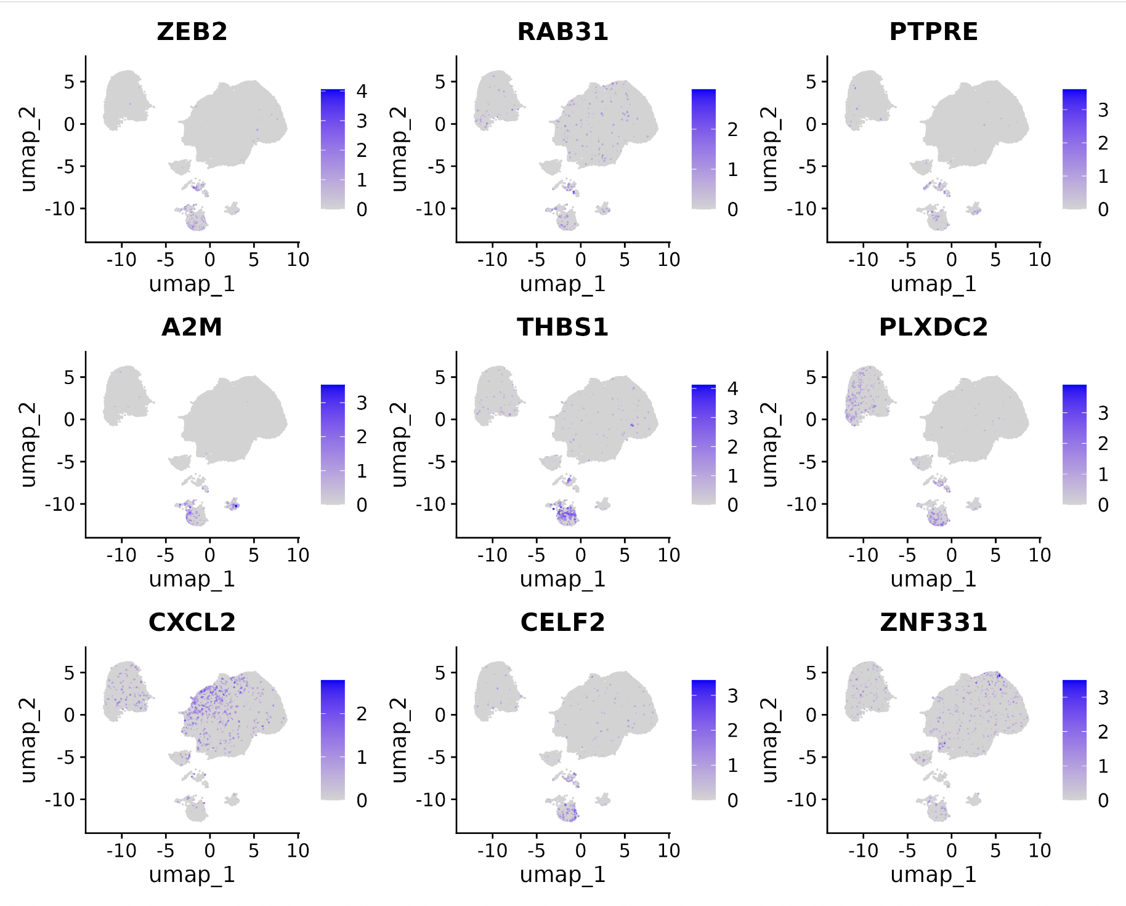
Scaled expression of additional macrophage cell type markers

Slide 17
Scaled expression of established mast cell type markers

Slide 18
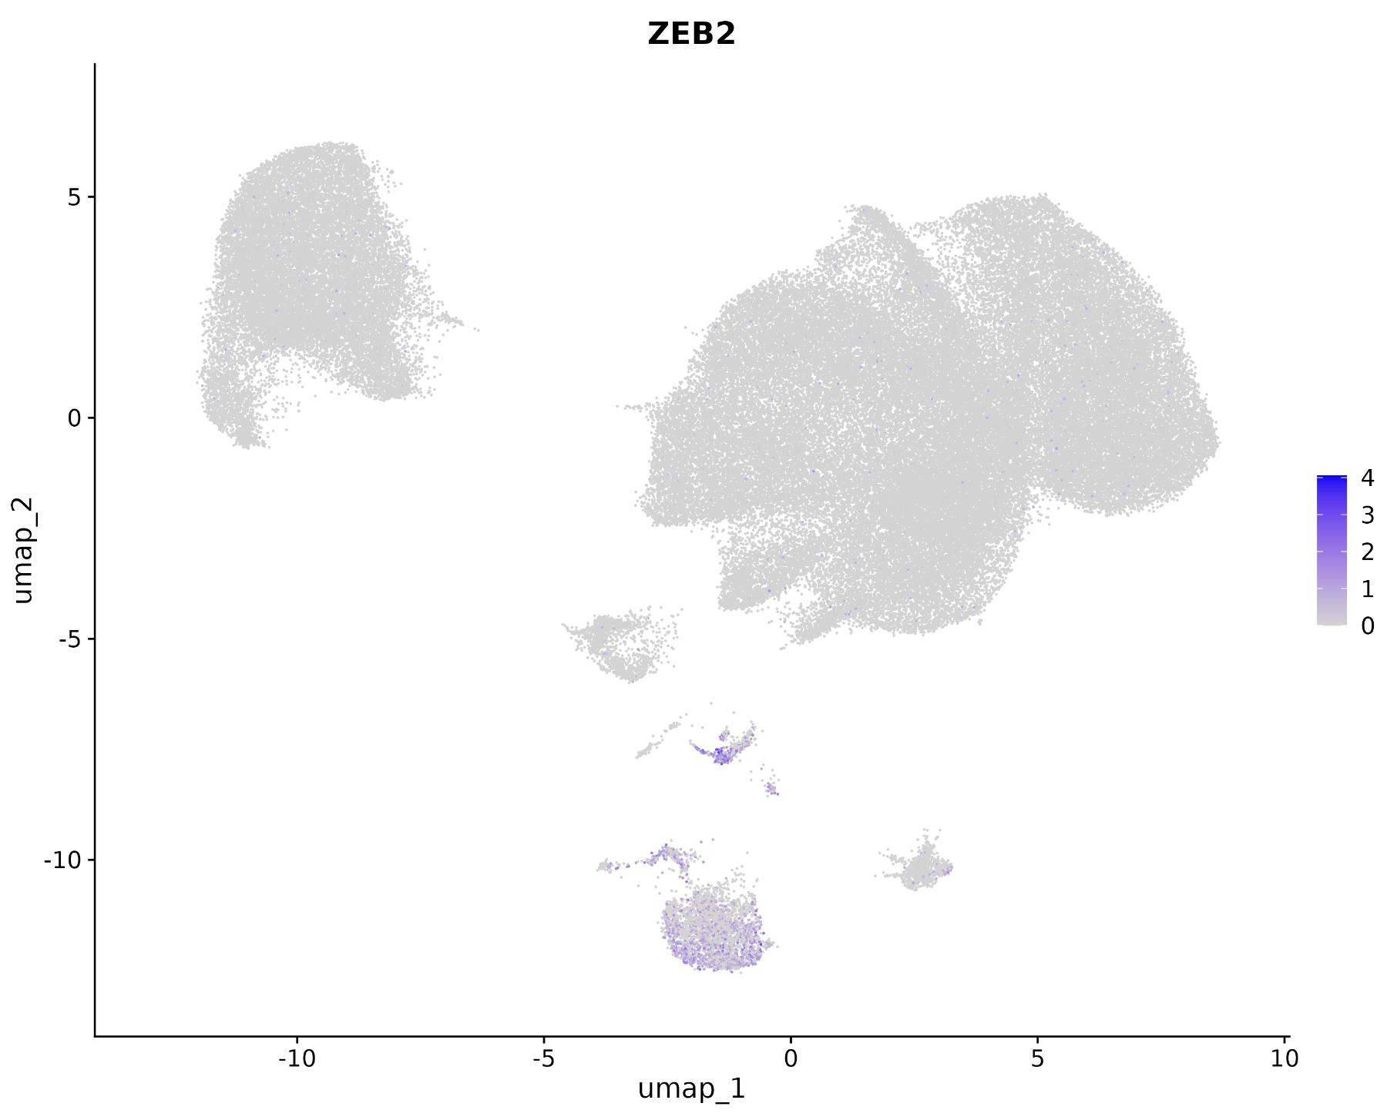
Scaled expression of additional mast cell type markers

Slide 19
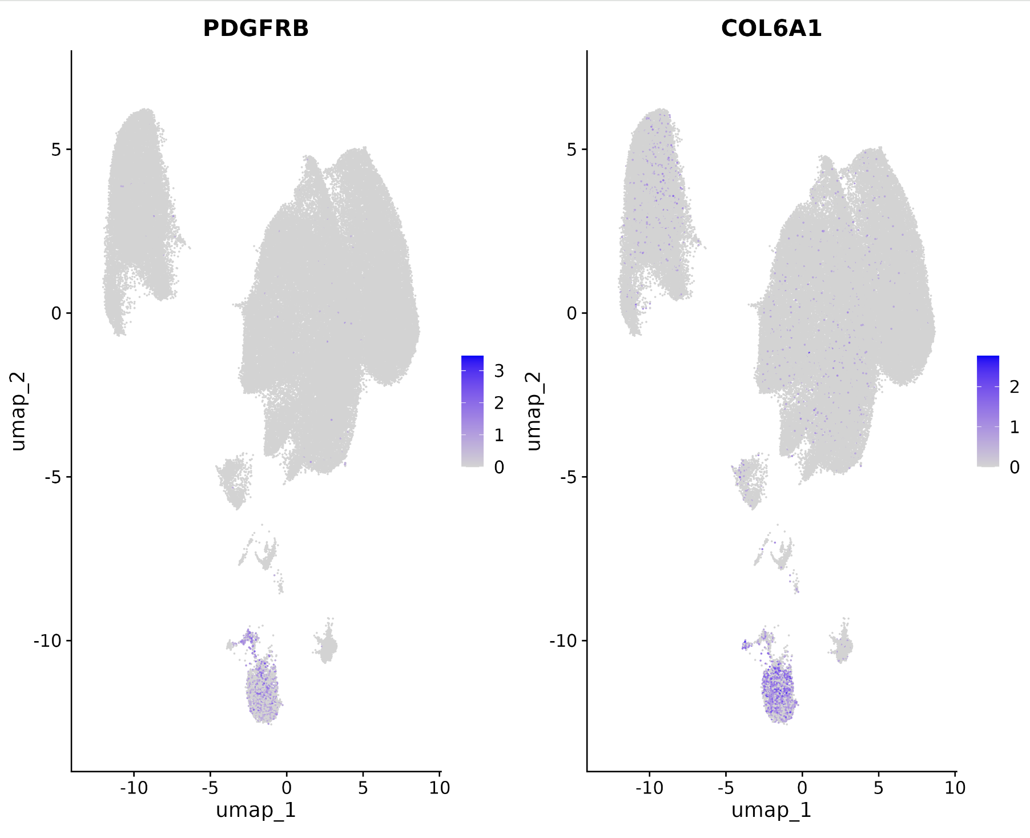
Scaled expression of established stellate cell type markers

Slide 20
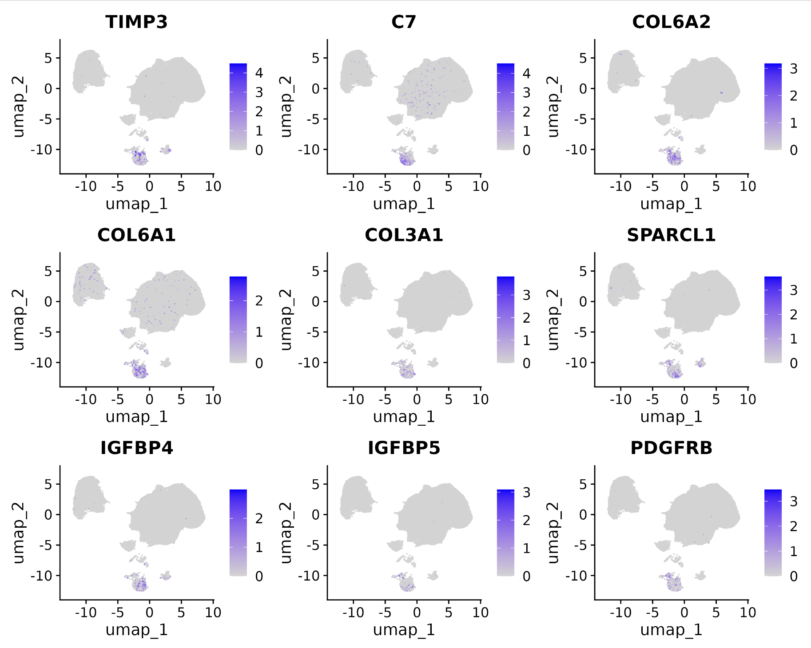
Scaled expression of additional stellate cell type markers

